Slide 1

Технологии машинного обучения Machine learning technologies
Lecture 4 - Optimization methods

Slide 2
Optimization Techniques Trends
1. Methods for solving weakly formalized problems are being developed. In the general case, these are non convex problems and / or problems with an unknown type of objective function.
- Then most of the methods guarantee the search for only the local minimum, but for most problems this is sufficient.
2. Due to the growth of computing power, it is possible to obtain results on relatively slowly converging algorithms, but at the same time making it possible to find the global optimum of a multidimensional function, or at least a fairly acceptable local one.
3. Hybrid approaches that combine the advantages of different optimization methods are becoming popular.
- There are no universal algorithms, therefore, to effectively solve the problem, you need to build an algorithm taking into account the specifics of this problem. This can often be done using combinations of known methods.

Slide 3
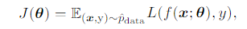
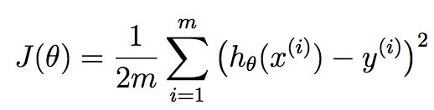
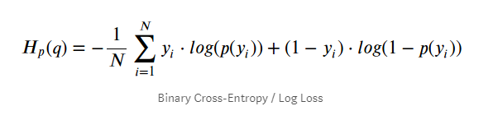
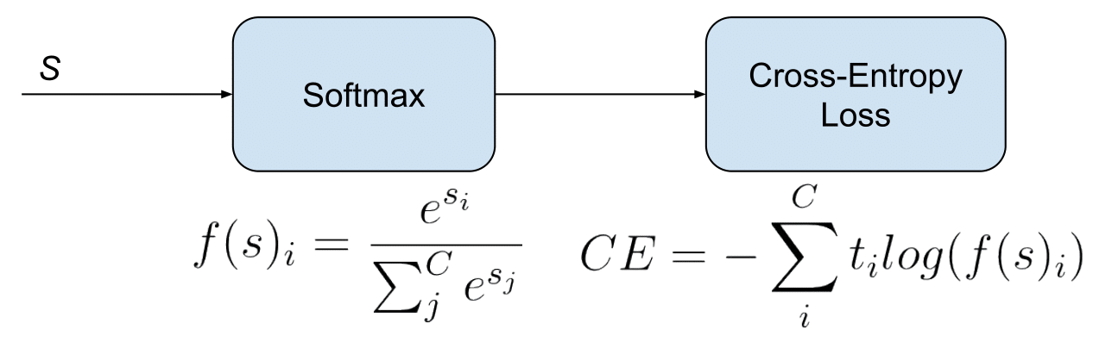
Optimization and machine learning
Optimization task:
ﬁnding the parameters θ of a model that signiﬁcantly reduce a cost function J(θ), which typically includes a performance measure evaluated on the entire training set as well as additional regularization terms.
J(θ) – function to optimize
Regression:
Binary classification:
Multiclassification:
Choosing the appropriate loss-function will highly affect the result of the training process
Binary cross-entropy (log-loss)
Softmax: Categorical Cross-Entropy

Slide 4
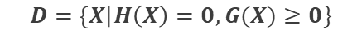

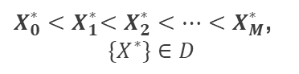

Practical formulation of numerical optimization
Setting the objective function = clarifying the properties of the objective function (unimodality, convexity, differentiability, etc.)
- Most of the target functions from real problems do not have properties that facilitate their optimization
Setting constraints
* In most real-life problems, they tend to go to unconstrained optimization (for example, by introducing penalty functions)
Dimension of the problem (it makes sense to reduce it)
* Most real problems have a high dimension (in the general case, the complexity of optimization grows exponentially with increasing dimension), but not all measurements are equally useful, so you can exclude insignificant
Ultimate goal: getting a global or local minimum?
* In most real problems, it is enough to find a local minimum if it satisfies some criterion (for example, the economic efficiency of the solution)
Available resources (comp power / real time of task execution)
* Because in most cases local optimization is performed, then the actual dilemma is of the available number of tests and the desired proximity to the global optimum
$$\min_{X∈D⊂R^{N}}{f\left(X\right)=f(X^{∗})}$$
Arg_opt
Target function
Domain
$$D=\left\{X\right|H\left(X\right)=0, G(X)≥0\}$$
Limitations for the argument
Dependence of V from X
$$V_{i}=Var(E(f(X)|X_{i}))$$
Can be another settings
Global minimum
$X_{0}^{∗}$ ${<X}_{1}^{∗}<X_{2}^{∗}<…<X_{M}^{∗}$,
${\{X}^{∗}\}∈D$
Local minimum

Slide 5
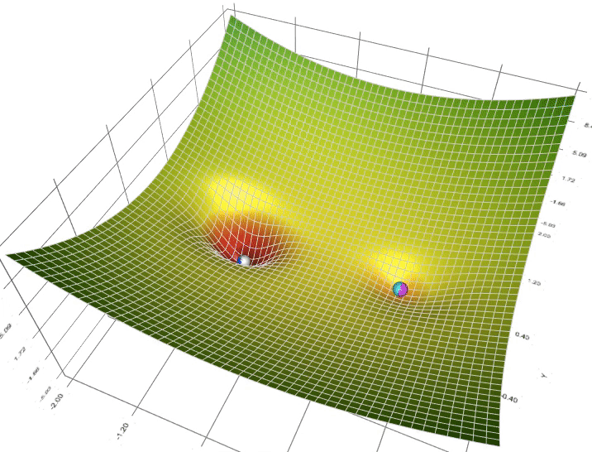
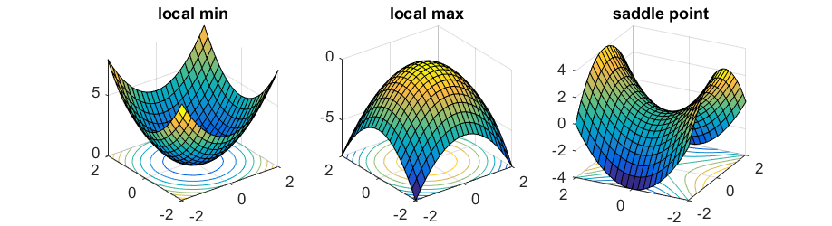
Global and local optimums

Slide 6
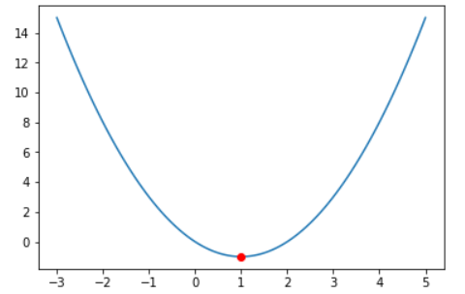
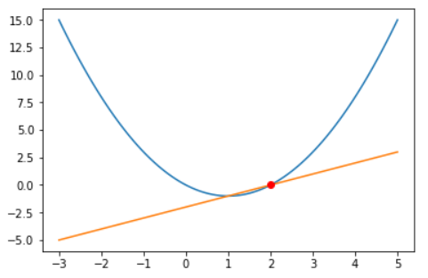
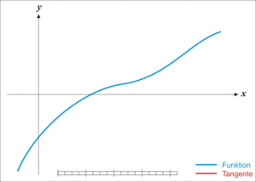
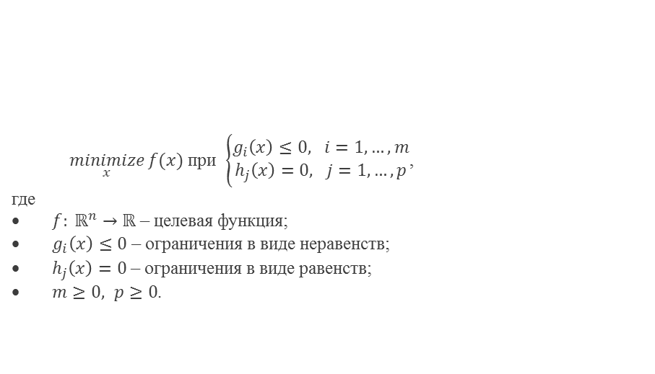
Newton methods
Setting the task
In general, the optimization problem
can be written as:
$\underset{x}{minimize}{f(x)}$ при $\left\{\begin{aligned}g_{i}\left(x\right)≤0, i=1,…,m \\ h_{j}\left(x\right)=0, j=1,…,p\end{aligned}\right.$,
где
$f: ℝ^{n}→ℝ$ – целевая функция;
$g_{i}\left(x\right)≤0$ – ограничения в виде неравенств;
$h_{j}\left(x\right)=0$ – ограничения в виде равенств;
$m≥0, p≥0$.
where
target function
conditions as inequalities
conditions as equalities
Unconditional min
Example for conditional min
Newton methods:
Newton's methods are root finding method that uses linear approximation. We guess a solution of x0 the equation y(x)=0, compute the linear approximation of y(x) at x0 and then find the x-intercept of the linear approximation.
Repeat iterations until convergence with the desired quality of root finding.
Usually faster than gradient methods but cannot pass the saddle points problem.
Visualization

Slide 7
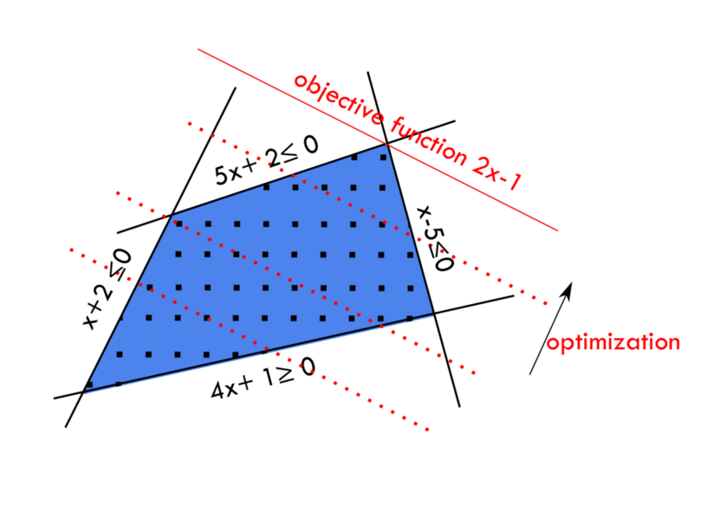
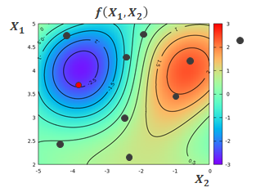
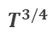

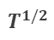
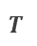
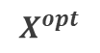
Non-gradient optimization methods
Depending on the specific properties of the objective function:
Linear programming algorithms
Quadratic programming algorithms
Depending on the dimension of the problem:
One-dimensional optimization (dichotomy, “golden” ratio, etc.)
Multidimensional optimization (coordinate descent, ravine method, etc.)
$$T^{1/4}$$
$$T^{1/2}$$
$$T^{3/4}$$
$$T^{}$$
Depending on the determinism of the algorithm:
Random search algorithms (Monte Carlo method, simulated annealing, etc.)
Population algorithms (evolutionary algorithms, swarm algorithms, etc.)
$$X^{opt}$$

Slide 8
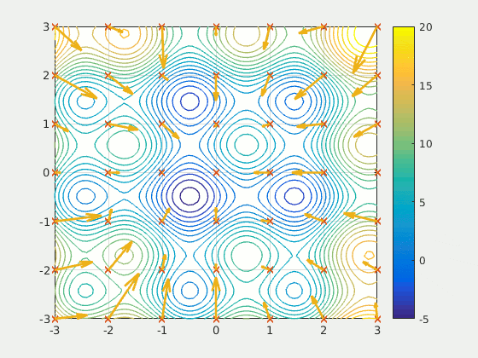
Population algorithms
Population optimization algorithm - an algorithm that searches for the optimum (minimum or maximum) of the objective function using a set of parallel tests (individuals) to calculate the objective function or population, whose individuals at each iteration change their position in such a way as to improve the value of the objective function on average population or for some individual.
Evolutionary optimization is based on iterative application of evolutionary operators to a population of candidate solutions.
Among the main operators used in evolutionary algorithms are:
selection, mutation, crossing (crossover)
For different population algorithms, the law of change in the properties of the population from iteration to iteration can be specified in different ways.

Slide 9
Advantages of the evolutionary methods
The advantages of evolutionary optimization methods include:
the ability to effectively detect the vicinity of the global minimum;
a balance between the expansion of the search space (exploration) and the refinement of the found minima (exploitation);
the ability to flexibly adapt to the problem being solved by implementing new evolutionary operators and tuning hyperparameters;
efficiency under conditions of the stochastic nature of the objective function surface;
the possibility of visual and interpretable visualization of the evolution process;
applicability for both discrete and continuous variables
ease of parallelization of the calculation of the objective function for individuals in the population;

Slide 10

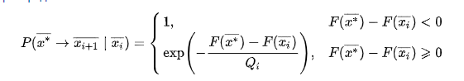
Simulated annealing method
Visualization of the method (en.wikipedia.org):
The probability of the transition:
(Gibbs distribution)

Slide 11
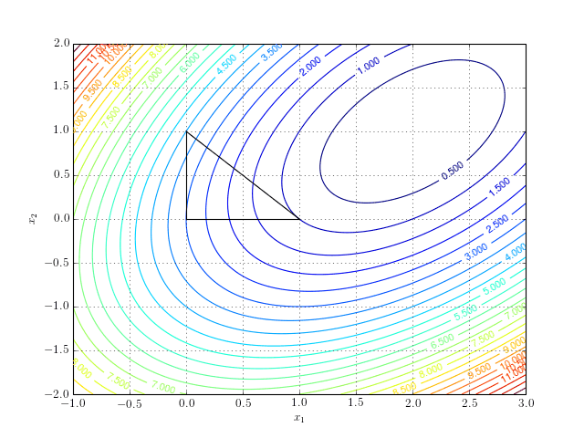
Nelder-Mead method (Simplex method or Amoeba method)
Simplex is a polytope of (n + 1) vertices in n dimensions.
Examples:
a line segment on a line,
a triangle on a plane,
a tetrahedron in 3D…
Randomly initialize the simplex and then:
Consequently apply:
Reflection
Expansion
Contraction
Shrink
until convergence.

Slide 12
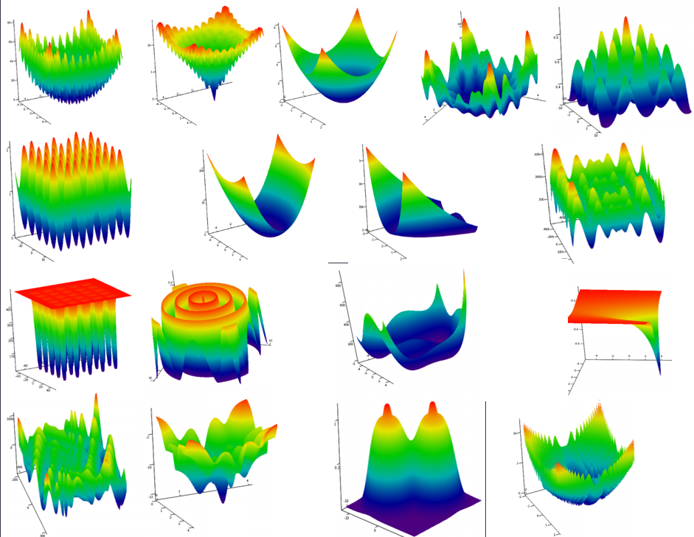
Test functions
Test functions allow you to evaluate:
Convergence;
Accuracy;
Robustness;
Performance;
The global optimum is known in advance (usually located at the origin)
Library of test functions for global optimization:
https://raw.githubusercontent.com/Harrix/HarrixTestFunctions/master/_HarrixTestFunctions.pdf

Slide 13
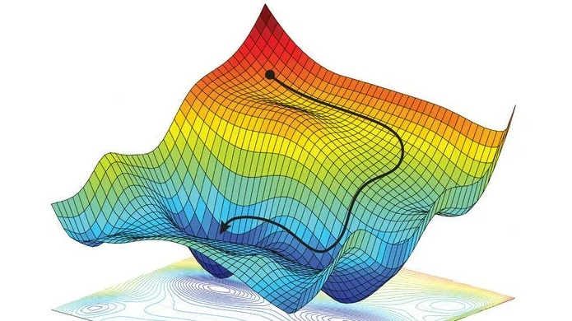
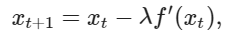
Classic gradient method
Gradient methods - are algorithms used to find (in the general case) the local minima of the differentiable function.
Visualization
(с en.wikipedia.org)
Gradient descent is an algorithm used to the find local minimums of any differentiable function.
more formally, given a differentiable function f(x), the gradient descent algorithms helps us compute x* such that f′(x*)=0 and x∗ is a minimum of f(x).
a function can have many local minimums x*1,x*2,…,x*m, the gradient descent algorithm will converge to one of them depending on the starting position and learning rate.
Suppose that f(x) is a differentiable function of one variable. At the current value, gradient describes the direction for convergence to a local minimum. The next point is defined from the following equation:
t - is the iteration number, λ – is the learning rate. For a given x1 and a large number of iterations T, the algorithm generates a sequence of points where Thus, x(t + 1) converges to x* for very large t.
It is worth noting that when the algorithm converges, f’(x,t) ≈0, and, therefore, |x(t + 1) - xt | ≈0. Thus, the generally accepted criterion for stopping the operation of the gradient descent is a decrease the value |x(t + 1) - xt | to the desired value. For example, you can tell the algorithm to run until
|x(t + 1) - xt | <0.001.

Slide 14
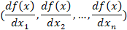
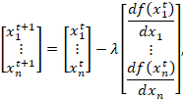
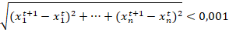
Classic gradient method
Consider a multiple variable and differentiable function f(x1,x2,…,xn). Our goal is to apply gradient descent and find a minimum (x*1,x*2,…,x*n). This function has partial derivatives stored in the gradient vector
The direction of the gradient vector indicates direction of steepest ascent, and the length of the gradient vector is a mesuare of the steepness. We can easily generalize the gradient descent to multiple variables as follows:
Visualization
(en.wikipedia.org)
where t - is the iteration number.
In this case, the stopping criterion is related to the Euclidean distance between the current and previous iterations, for example, you can set:

Slide 15
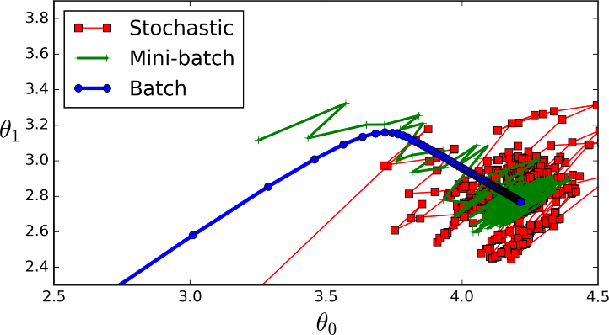
Stochastic gradient descent
The use of the gradient descent algorithm on a large training dataset can cause difficulties associated with the speed of convergence of the algorithm and the required computational power.
stochastic modification of the gradient method
Comparison
It is necessary to walk through all the data to calculate the gradient
and the new value θt. In the case of a large amount of data, this can be computationally expensive. Moreover, this approach cannot get around the problem of “falling” into local minima. Stochastic modification of the algorithm allows to partially solve both of these problems.
Stochastic gradient descent updates the parameters on the subset of data (i):
where J(θ) - is the objective function (loss function), θ - are model parameters, η -is the learning rate coefficient. For this, as can be seen from the formula, updating the weights does not require calculating the gradient over the entire dataset, which significantly saves computing resources.
The size of the "minibatch" - a subset of data - should be selected in each case separately.
Source:
https://hackernoon.com/gradient-descent-aynk-7cbe95a778da
“batch GD” → use whole dataset to update the weights
“minibatch GD” → use the subset of training examples
“stochastic GD” or “online GD” → use randomly chosen objects

Slide 16
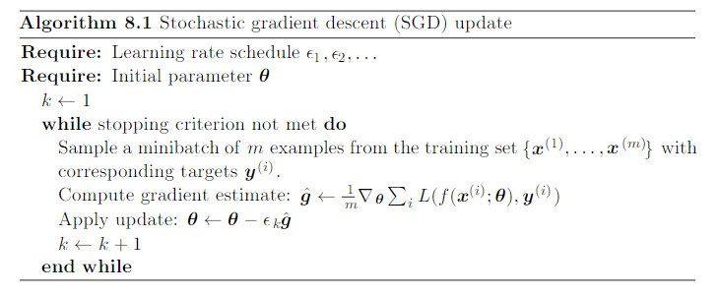
Stochastic gradient method

Slide 17
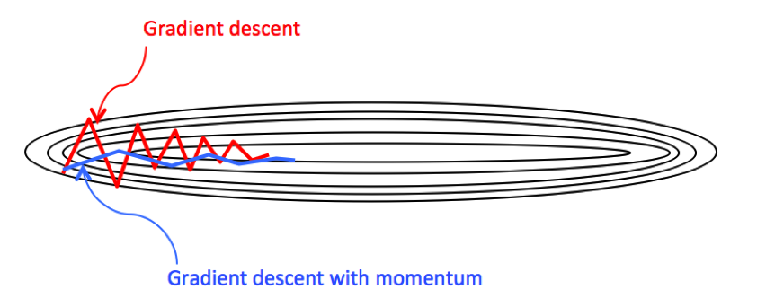
Gradient descent method with inertia (Momentum method)
This method speeds up the movement of the gradient descent towards the extremum and reduces oscillations in the wrong directions. The algorithm uses the β fraction of the gradient vector from the previous iteration and the (1-β) fraction of the current gradient vector.
This is a complete analogue of the so-called exponential smoothing function:
,
where gt is the gradient at the current iteration. Usually β is set equal to 0.9, which makes it possible to take into account the inertia of motion accumulated over the previous iterations to a greater extent, and to pay less attention to new changes. Hence the analogy with physics: we "by inertia" move in the chosen direction, gradually refining it, receiving information from new data.

Slide 18
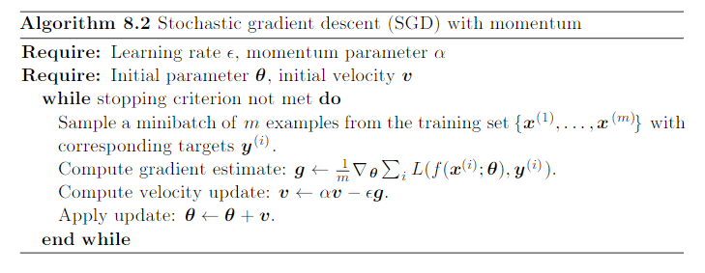
Gradient descent method with inertia (Momentum method)

Slide 19
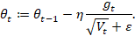
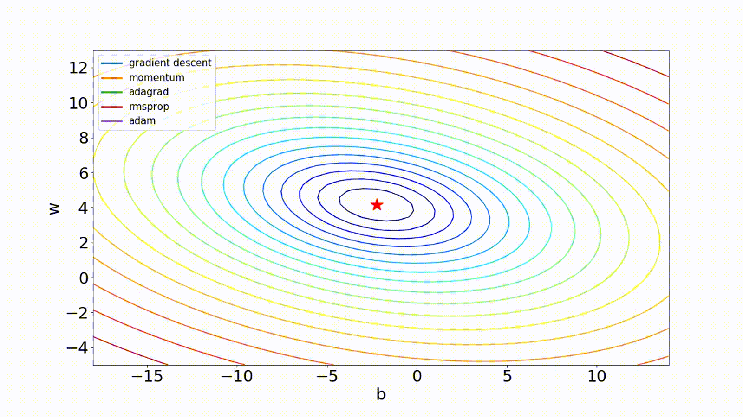
RMSprop (Root Mean Square propagation)
The RMSprop (Root Mean Square propagation) algorithm updates the parameters taking into account the squares of the gradients at the current step and has a slightly modified rule for updating the weights:
Realizations of SGD modifications
where ε is a small increment to avoid dividing by 0. The adaptive learning rate factor with square root in the denominator in the last formula provides a moderate shift in the desired direction towards the local minimum point.
In other words, the larger the "accumulated" gradient V_t of the "current" gradient g_t, the less the weights will change at each step.
Source: https://github.com/ilguyi/optimizers.numpy

Slide 20
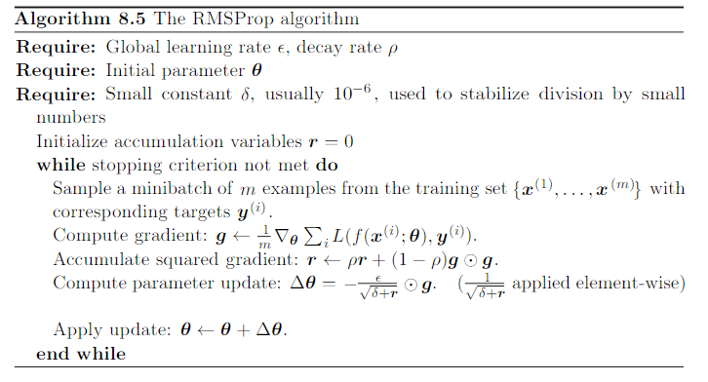
RMSprop (Root Mean Square propagation)

Slide 21
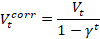
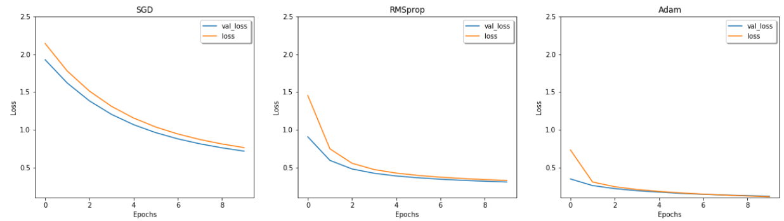
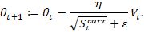
ADAM algorithm
Adam (Adaptive momentum algorithm)
one of the most popular optimization algorithms in deep learning;
combines Momentum and RMSprop;
an adaptive learning rate is calculated and exponential moving averages of gradients and gradient squares are stored;
corrected gradients can be introduced to “slow down” the speed of movement to the optimum as the iteration number t increases:
.
where γ is a number from 0 to 1.
Hyperparameters of the Adam algorithm:
learning rate η,
coefficients β1, β2,
ε.
The moving averages of the gradients and gradient squares,
Vt and St respectively, are calculated as follows:
Dynamics of finding the minimum of the optimized function using stochastic gradient algorithms on the MNIST dataset
Updating weights rule:
Recommended values:

Slide 22
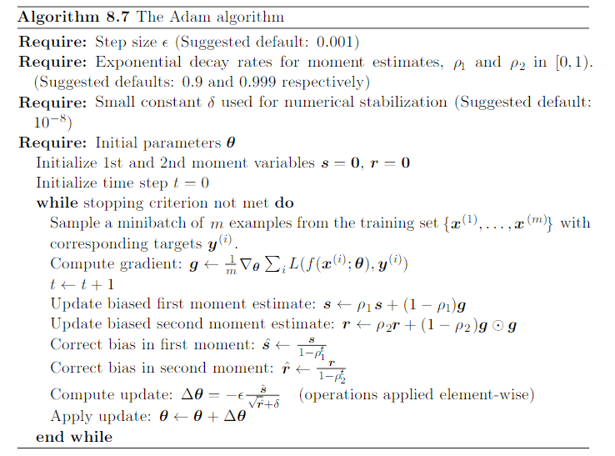
ADAM algorithm

Slide 23
Realizations of SGD modifications
Source: https://github.com/ilguyi/optimizers.numpy

Slide 24
Problems with optimization process in ML
Problems:
local minimums
saddle points
vanishing gradients
exploiding gradients
computational resources
Possible solutions:
finetuning of optimization methods
weights initialization techniques
improve the architecture of NN and hyperparameters tuning
- combinations of methods

